Slide 1
Assignment - 06
Machine Learning Project
Done by : Sadhvi j
Submitted To : CVSN Reddy

Slide 2







WHAT IS ARTIFICIAL INTELLIGENCE?
AI is intelligence demonstrated by the machine, where the human intelligence is put into the machine.

Slide 3
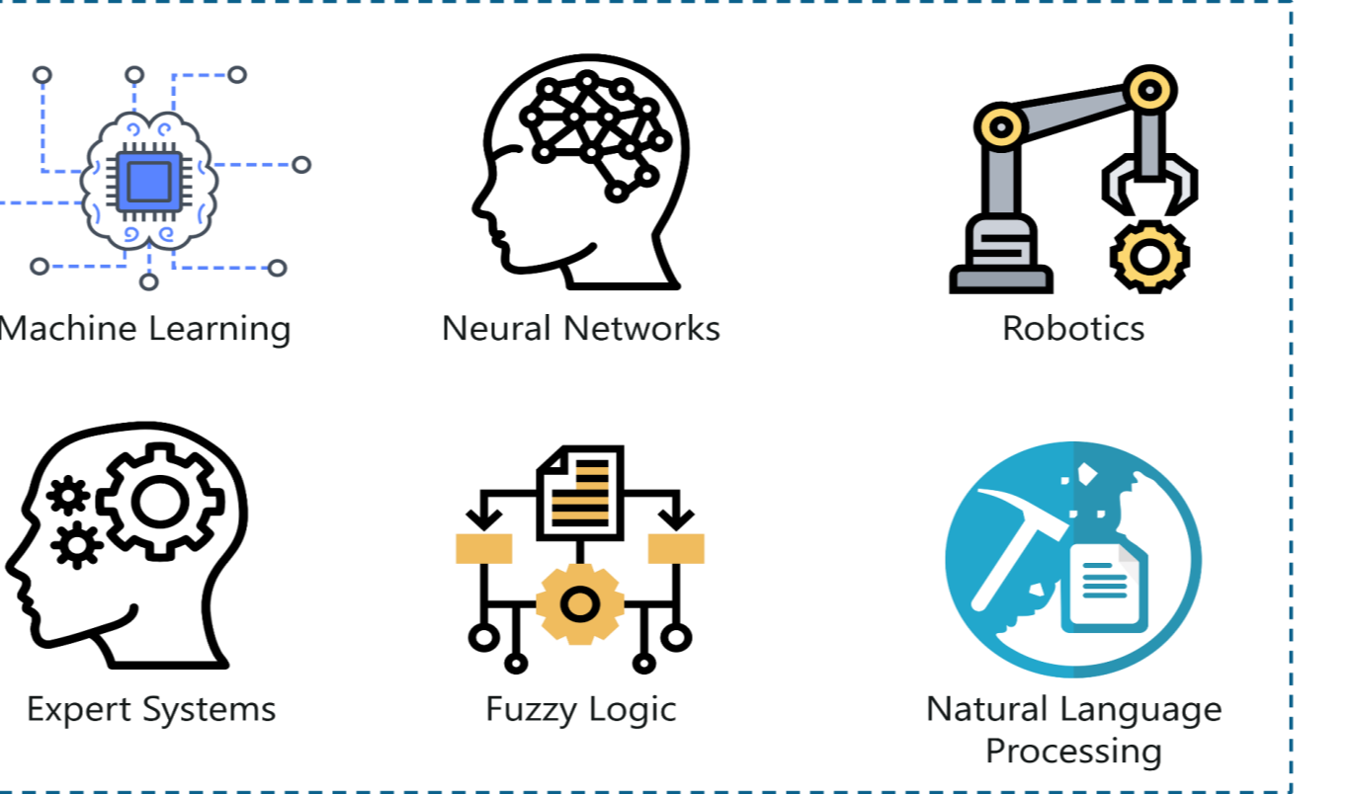
BRANCHES OF AI:

Slide 4


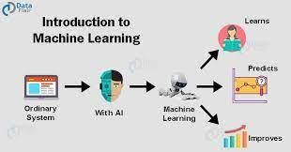
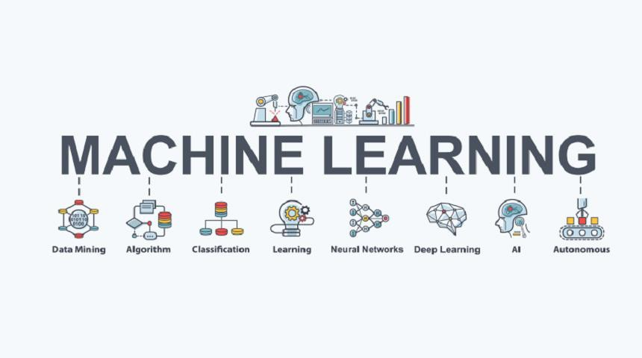
WHAT IS MACHINE LEARNING?
ML is making the computer to learn.
It is giving input and output to machine learning algorithm and it builds a model. It predicts the future.

Slide 5
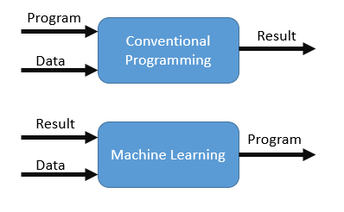
MACHINE LEARNING

Slide 6








SUPERVISED LEARNING
METHODS OF LEARNING:-
UNSUPERVISED LEARNING
REINFORCEMENT LEARNING

Slide 7

WHAT
IS SUPERVISED LEARNING?
Learning from others is called SUPERVISED LEARNING.
Will have features and
labels.
There are two algorithms -
REGRESSION
CLASSIFICATION

Slide 8

WHAT IS UNSUPERVISED LEARNING?
▶ Learning on our own is called as UNSUPERVISED LEARNING.

Slide 9
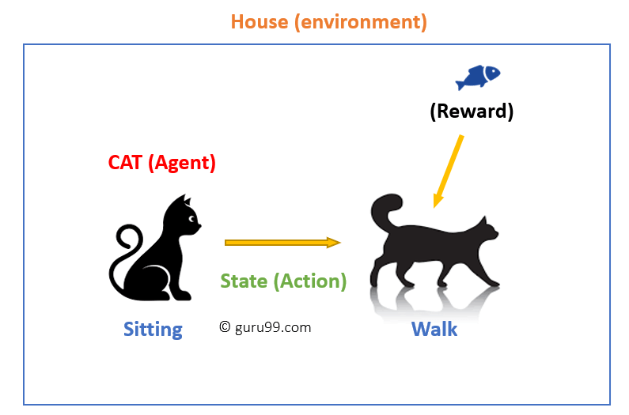
WHAT IS REINFORCEMENT LEAR NING?
▶ Machine learning method in which user is rewarded for the desired behavior or punished for undesired behavior

Slide 10
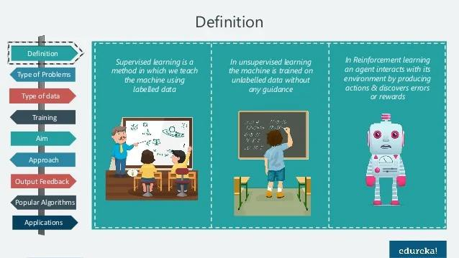

Slide 11
WHAT IS REGRESSION AND CLASSIFICATION?
REGRESSION
In regression the output variables must
be of continuous nature.
In regression we use only:
LINEAR REGRESSION
NON LINEAR REGRESSION
CLASSIFICATION
In Classification, the output variable must be a discrete value.
In classification we use:
LOGISTIC REGRESSION
DECISION TREE
RANDOM FOREST
K NEAREST NEIGHBOUR [KNN]
SUPPORT VECTOR MACHINE [SVM]
NAÏVE BAYES

Slide 12
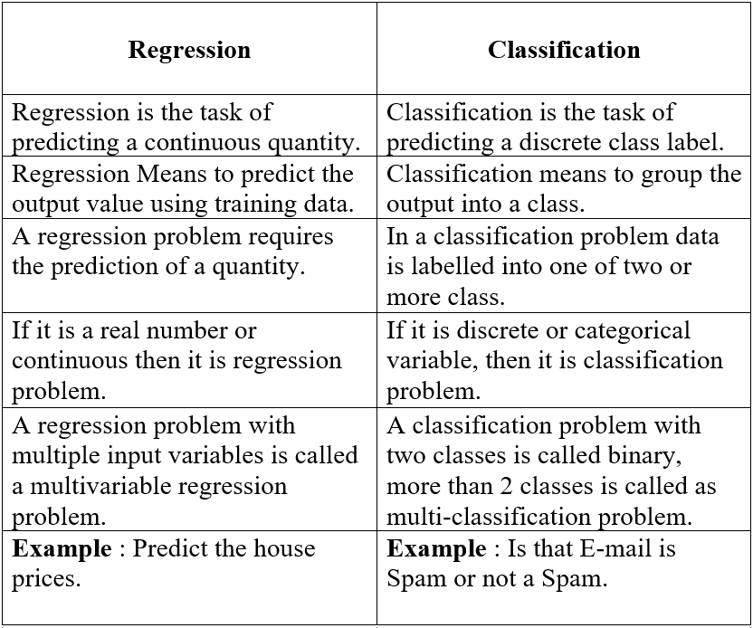

Slide 13
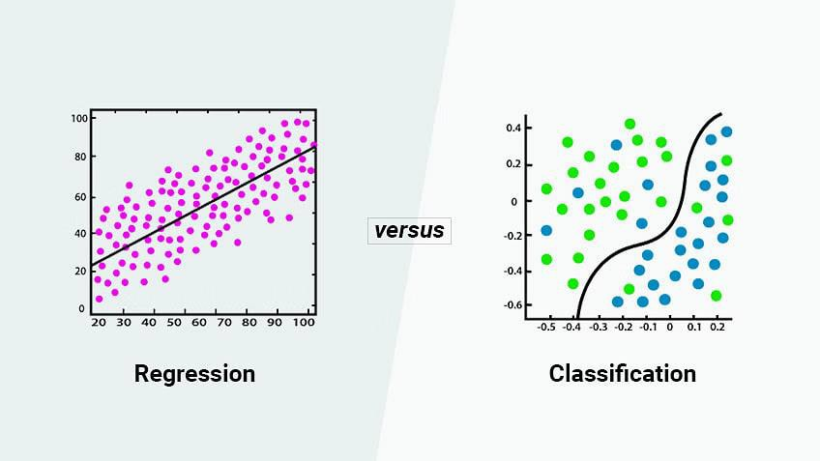
REGRESSION VS CLASSIFICATION

Slide 14
MACHINE LEARNING ALGORITHMS:
Linear regression.
Non Linear regression.
Logistic regression.
Decision tree.
Random forest.
KNN (K
Nearest Neighbour).
SVM (Support Vector Machine).
Naïve bayes.

Slide 15
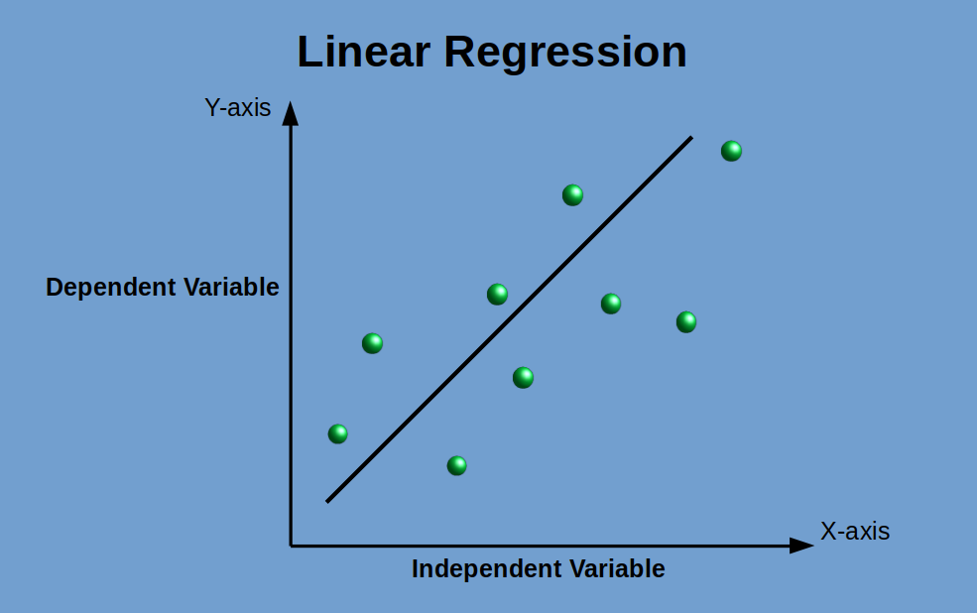
LINEAR REGRESSION:
▶ LINEAR REGRESSION is used to predict the value of the variable based on the value of the another variable.
▶ It relates two variables (X and Y) with a straight line (y = mx + b).

Slide 16
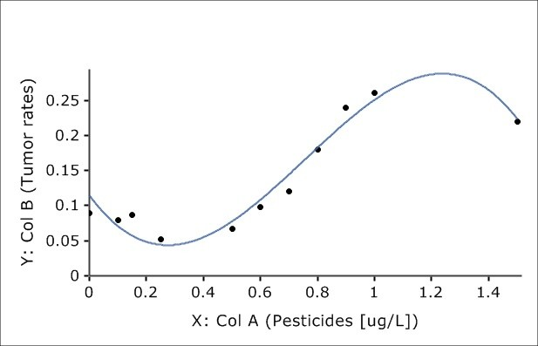
NON LINEAR REGRESSION:
▶ NON LINEAR REGRESSION is a form of regression analysis in which data is fit to a model and then expressed as a mathematical function.
▶ It relates the two variables in a nonlinear (curved) relationship.(such as x^2 , x^3...).

Slide 17
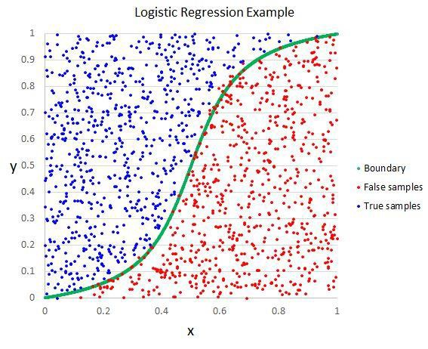
LOGISTIC REGRESSION:
▶ LOGISTIC REGRESSION estimates the probability of an event occurring, such as voted or didn't vote, yes or no, based on a given dataset of independent variables.

Slide 18
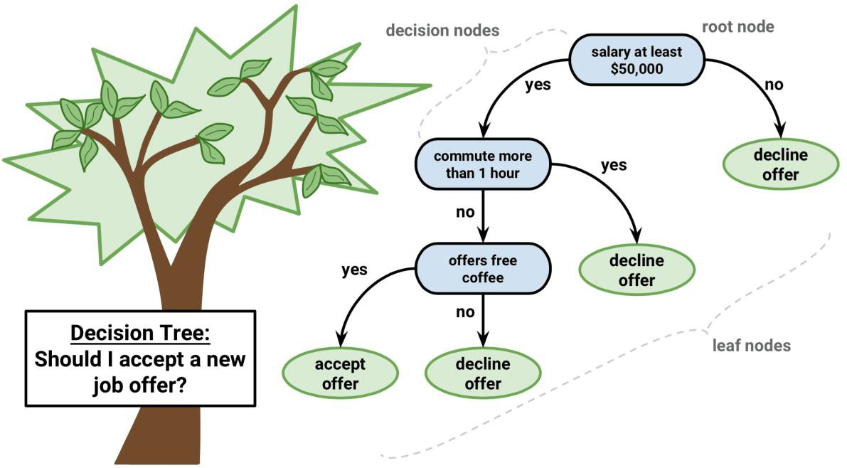
DECISION TREE:
▶ It belongs to supervised learning algorithm and it can be used in both regression and classification.

Slide 19


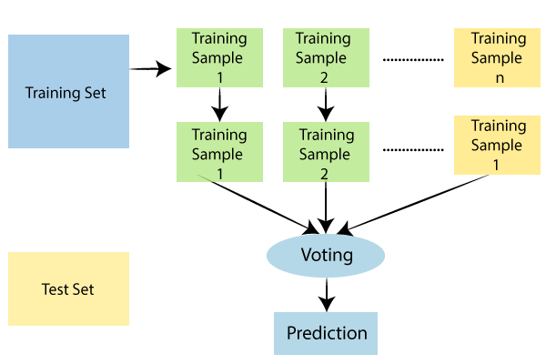

RANDOM FOREST:

Slide 20
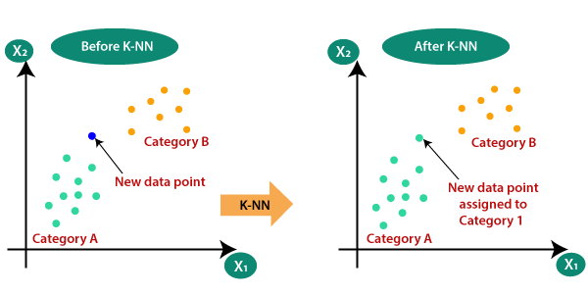
KNN(K
Nearest Neighbour):

Slide 21
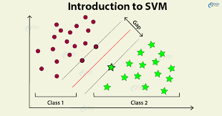
SVM
(Support Vector Machine ):

Slide 22
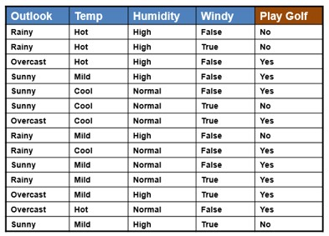
NAÏVE BAYES:

Slide 23

EXPLAIN FEATURES, LABELS AND MODELS IN
ML WITH MATHS.
▶ X=3 F(x)=9
▶ X=4 F(x)=12
▶ X=5 F(x)=15
▶ X=6 F(x)=18
▶ What is X=8?
▶ F(x)=3x
▶ Inputs are called Features.
▶ Outputs are called Labels.
▶ Functions are called Models.

